Slide 1

FREELANCEGIG ANALYTICS
Comprehensive Analysis of Gig Economy

Slide 2
BUSINESS INTRODUCTION
FreelanceGig Analytics is a data-driven company focused on analyzing trends in the gig economy. The company provides insights into freelancer earnings, job success rates, and market trends across various platforms. By analyzing freelancer performance and earnings, FreelanceGig Analytics helps businesses, freelancers, and policymakers make informed decisions

Slide 3
PROBLEM STATEMENT
The gig economy is expanding rapidly, with freelancers offering services across a variety of platforms. However, clients often face challenges in identifying the most effective platform for hiring qualified talent.
FreelanceGig Analytics aims to uncover disparities in freelancer performance, earnings, and client satisfaction across different platforms and job categories. By evaluating variations in freelancer outcomes based on platform, job type, and experience level, the company seeks to optimize job matching, improve compensation strategies, and enhance platform engagement for better decision-making by businesses, clients and freelancers.

Slide 4
RATIONALE FOR THE PROJECT
Analyze freelancer job trends.
Assess freelancer earnings.
Identify key success factors.
Develop interactive dashboards

Slide 5
PROJECT WORKFLOW
Data Importation into Tableau
Joining Tables
Creating Charts
Creating Dashboards
Recommendations

Slide 6

KEY INSIGHTS
Average earnings by job category
Experience Level Impact
Platform-Specific Client Ratings
Job Success Rate
Rehire Rate by Platform
Platform-Specific Trends(Table view)

Slide 7
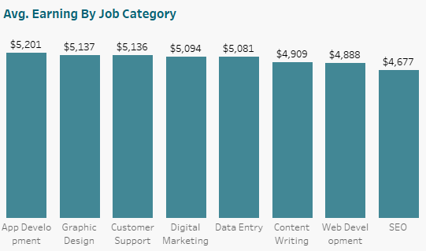
App Development earns the most with an average of $5,201, while SEO has the least average earnings with $4,677
Notes:
App Development earns the most with an average of $5,201, while SEO has the least average earnings with $4,677

Slide 8
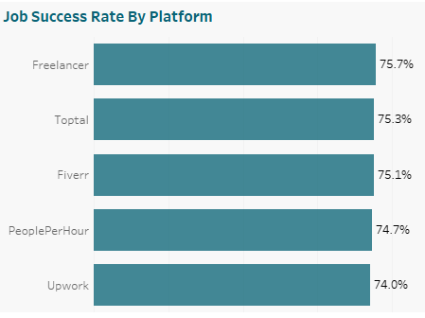
All the platforms have a 74%+ success rate, with Freelancer topping at 75.7%, and Upwork has the least success rate with 74%
Notes:
App Development earns the most with an average of $5,201, while SEO has the least average earnings with $4,677

Slide 9
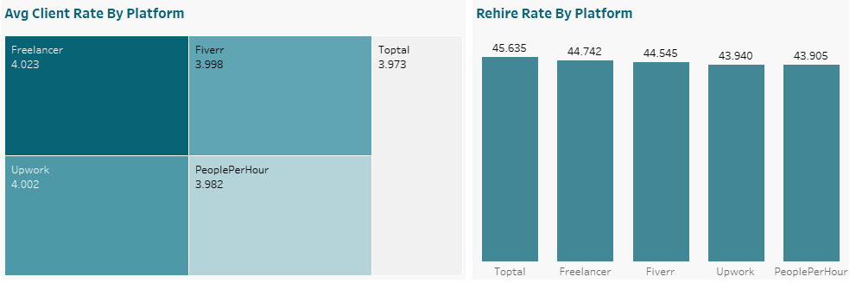
Freelancer and Upwork has the highest average rating by Client with 4.02, and 4.0 respectively while Toptal has the lowest average rating at 3.97. Toptal has the highest rehire rate, even though it has the lowest client rating, this could be down to the fact that even though the client rate is the lowest, the hourly rate is also the lowest, making it the most affordable to most clients. Also, Toptal also has the second highest success rate, which could explain why clients rehire it the most while PeoplePerHour is the most expensive platform based on average hourly rates, and this may contribute to why it is the least rehired platform.
Notes:
App Development earns the most with an average of $5,201, while SEO has the least average earnings with $4,677

Slide 10
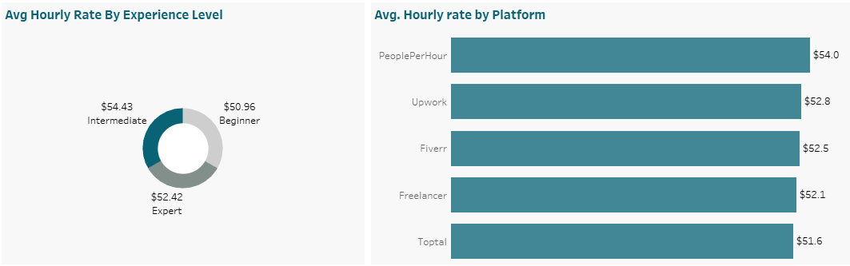
Intermediate personel earn $2+ averagely than experts per hour, while Beginner level personnels earn the least per hour. PeoplePerHour has the highest average hourly rate while Toptal has the lowest.
Notes:
App Development earns the most with an average of $5,201, while SEO has the least average earnings with $4,677

Slide 11
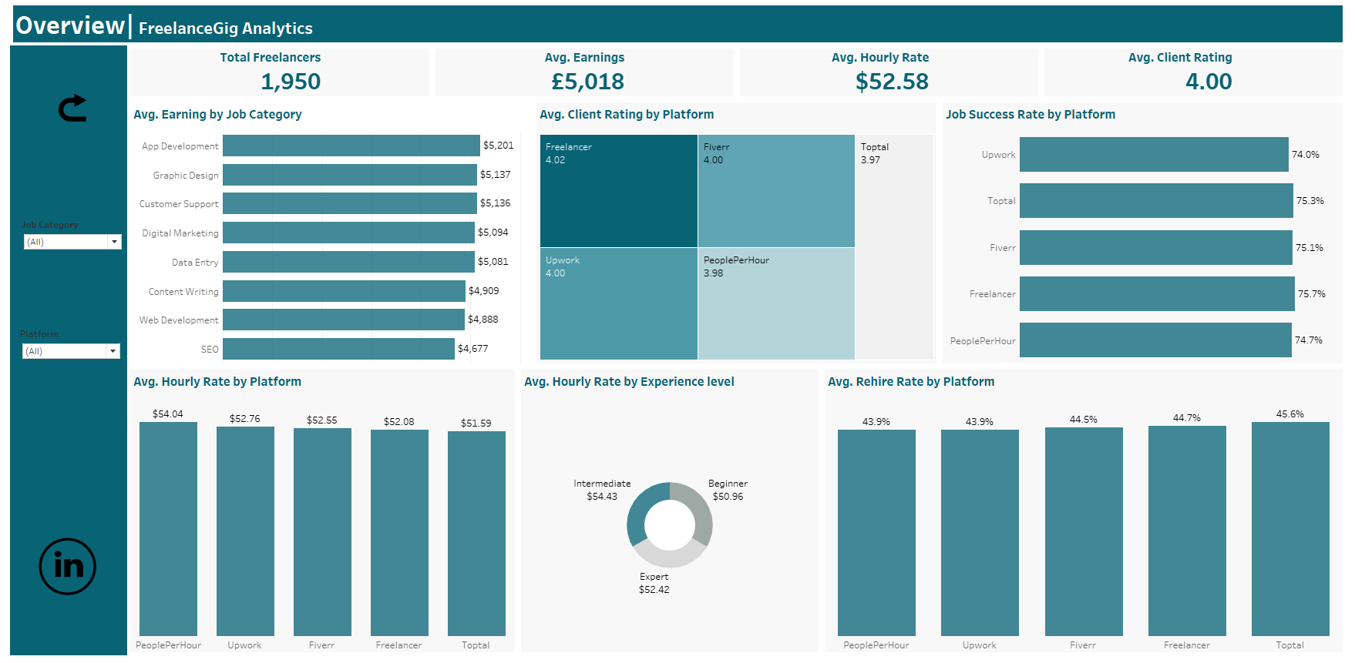

Slide 12
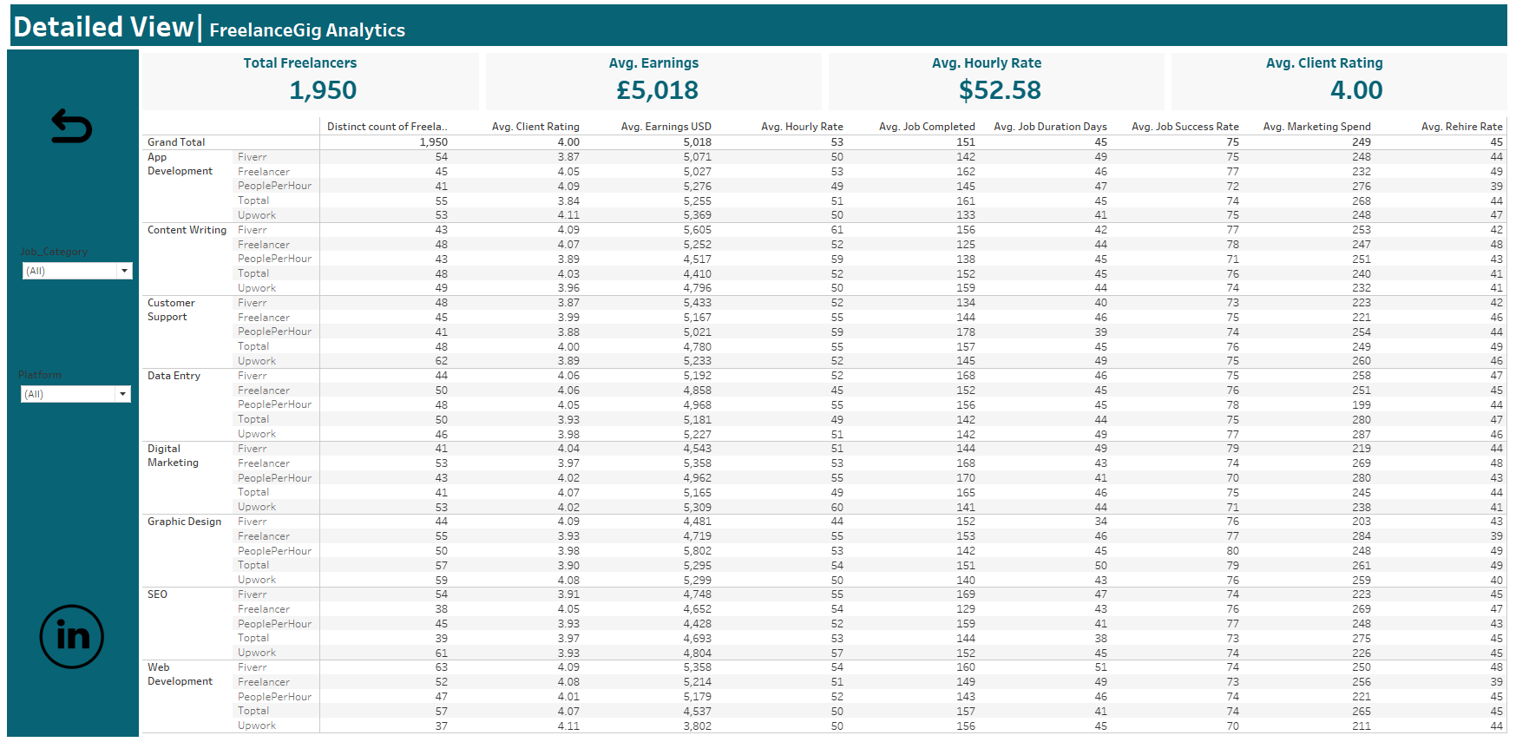

Slide 13
SUMMARY
FreelanceGig Analytics analyzed freelancer performance data across major gig platforms to identify optimal strategies for both freelancers and clients.
Key findings reveal App Development as the highest-paying category ($5,201 avg), intermediate freelancers surprisingly out-earning experts, and Toptal leading in rehire rates despite lower ratings due to affordability.
All platforms maintain strong 74%+ success rates, with strategic platform selection proving crucial for maximizing earnings and client satisfaction.

Slide 14
RECOMMENDATION
For Freelancers:
Prioritize job categories such as App Development and Graphic Design for higher earning potential.
Consider targeting platforms like Freelancer and PeoplePerHour for higher success and rehire rates.
Leverage experience level to negotiate better rates; invest in skill growth to move from Beginner to Intermediate tier.
For Clients
Platform Selection Matters: For better success rates and job satisfaction, prefer platforms like Freelancer and PeoplePerHour.
To maximize rehire potential, identify freelancers with strong historical data (high rehire rates and client ratings).
For FreelancerGig Economy Stakeholders:
Promote standardization in job evaluations across platforms to reduce discrepancies.
Encourage transparent reporting of freelancer performance and job success metrics.
Support initiatives that help beginner freelancers upskill to bridge the earnings gap.

Slide 15
Thank You For Listening

